Slide 1
Setting a treatment room at your church

Slide 2
What is a Treatment Room
"In every city where we have a church, there is need of a place where treatment can be given. Among the homes of our church members there are few that afford room and facilities for the proper care of the sick. A place should be provided where treatment may be given for common ailments. The building might be inelegant and even rude, but it should be furnished with facilities for giving simple treatments. These, skillfully employed, would prove a blessing, not only to our own people, but to their neighbors, and might be the means of calling the attention of many to health principles". – {CH 468.1}

Slide 3
Purpose of Treatment Rooms
“God's purpose in giving the third angel's message to the world is to prepare a people to stand true to Him during the investigative judgment. This is the purpose for which we establish and maintain our publishing houses, our schools, our sanitariums, hygienic restaurants, treatment rooms, and food factories This is our purpose in carrying forward every line of work in the cause” MS 143, 1902.

Slide 4
Treatments
Migraine headache
Upper back pain
Lower back pain: sciatica
Arthritic pain
Injury pain
Pain related to cancer

Slide 5
Steps to Set a Treatment Room
Learning simple natural remedies
Do a natural remedies class
Present the idea to the church
Choose an area to set the treatment room
Present budget to the church board
Form a team of at least 4 people
Obtained items needed for the treatment room

Slide 6
Timing
Suggestion:
  Open the treatment room on weekly basis
  Sabbaths after potluck (2-4pm)

Slide 7
Promote Treatment Room Therapies
Create flyers
Pass flyers to members (start with members)
Pass flyers to the community
Be consistent having therapies available

Slide 8
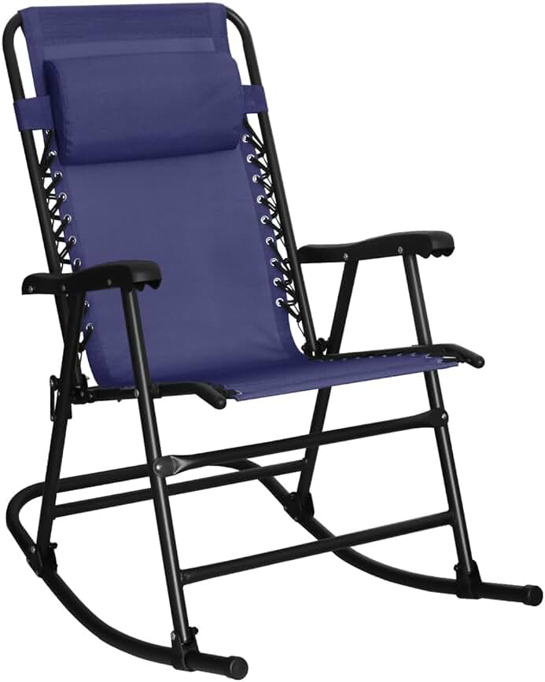
Chair for Hydrotherapy

Slide 9
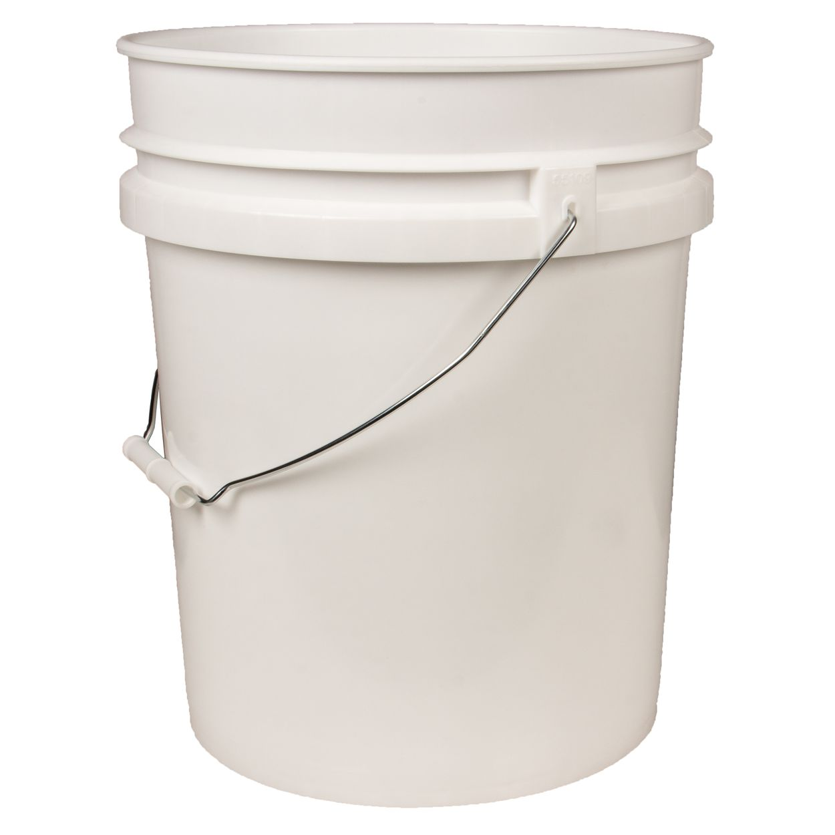
5-gallon bucket

Slide 10
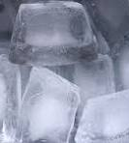
Ice
For ending hydrotherapy

Slide 11
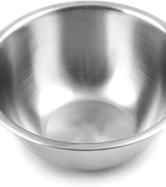
Bowl
For ice water

Slide 12
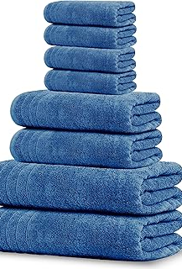
Cotton Towels for Hydrotherapy

Slide 13
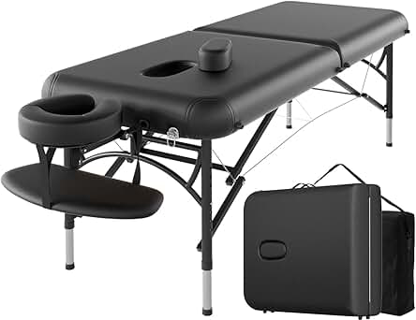
Massage Table for back pain treatment

Slide 14
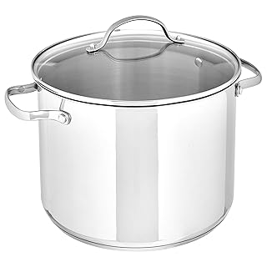
Pot for hot water
To use for hydrotherapy for pain using towels

Slide 15
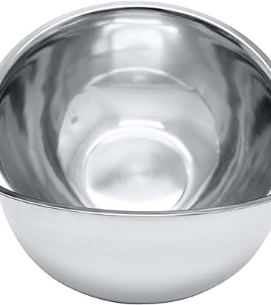
Bowls For hydrotherapy for hot water and ice water
One for ice cool water
One for spelling of water

Slide 16
Ice
For ending hydrotherapy

Slide 17
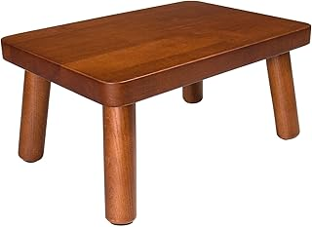
Wooden stool
It should be short

Slide 18

plastic

Slide 19
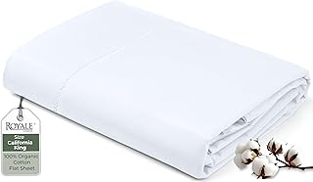
one cotton sheets

Slide 20
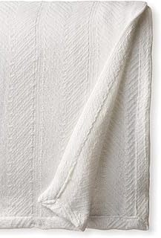
Cotton Blanket for Sauna
For wrapping patient

Slide 21
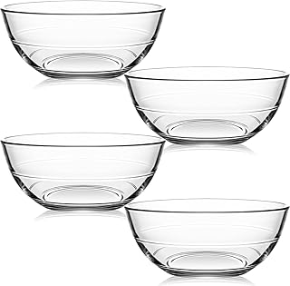
Bowls for poultices

Slide 22
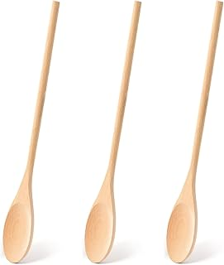
Wooden spoons
For making paste for poultice

Slide 23
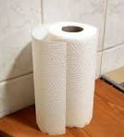
Paper towel
Paper towel to hold the ginger

Slide 24
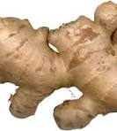
Ginger
Grind ginger

Slide 25

Press’ nseal
To keep poultice in place

Slide 26

Ginger power for poultice

Slide 27
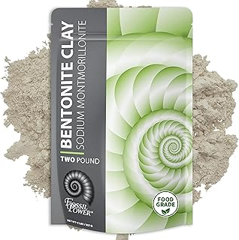
Bentonite Clay

Slide 28
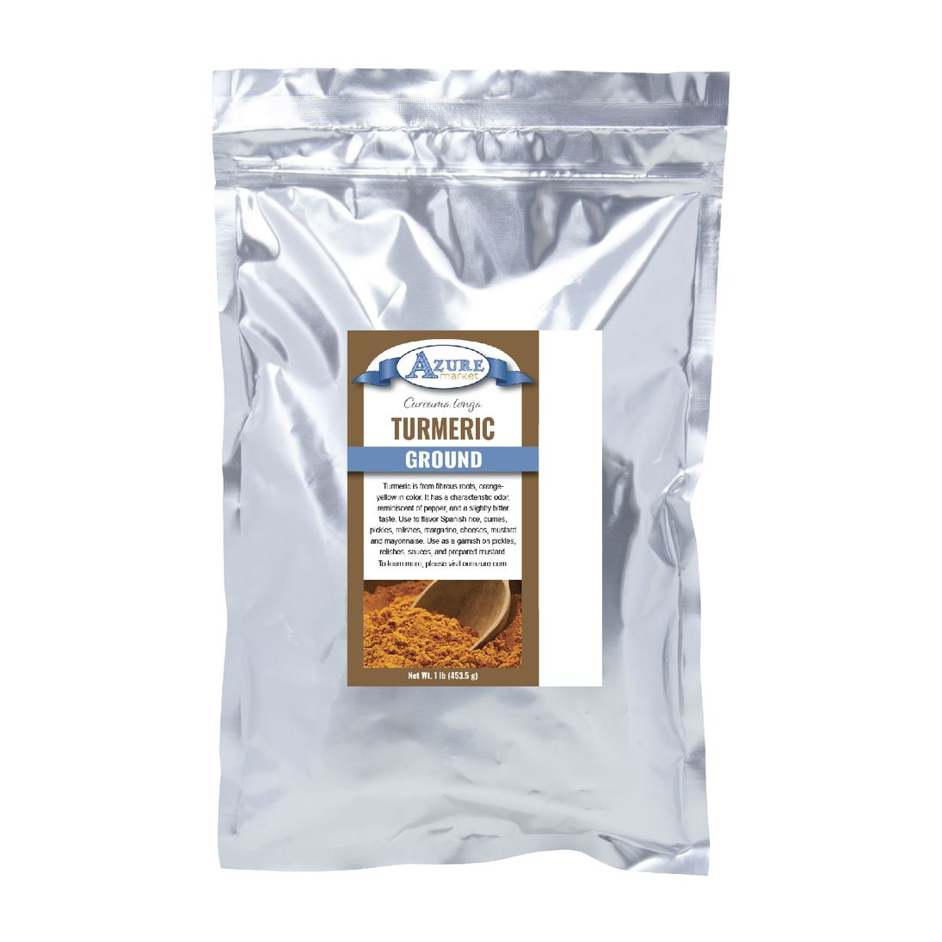
Turmeric for poultice

Slide 29
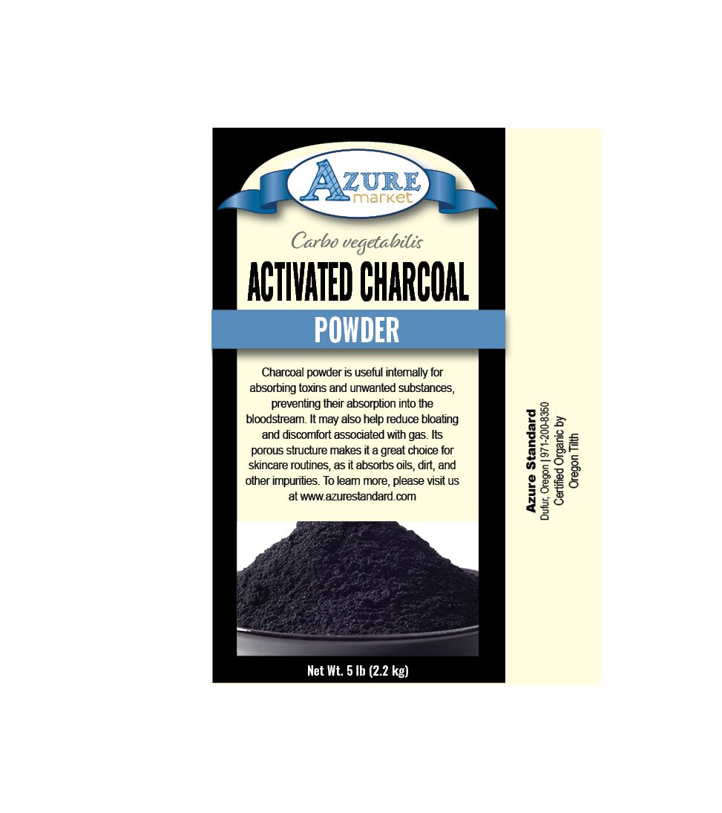
Charcoal for poultice

Slide 30
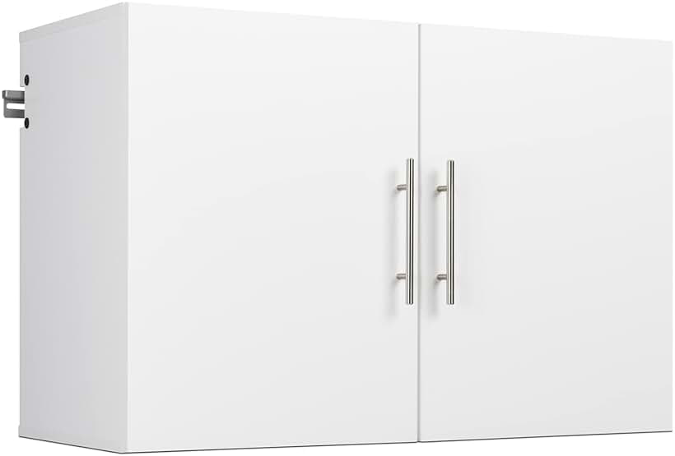
2 Wall dressers for hydrotherapy and for poultices supplies

