Slide 1


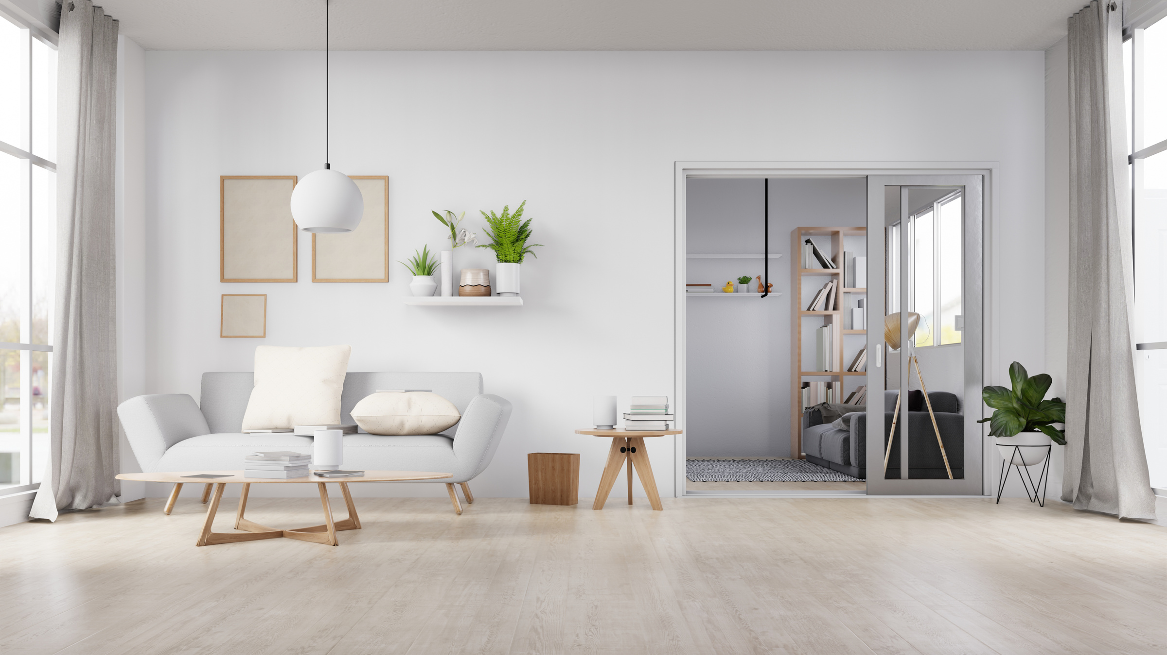
YOUR ROADMAP FOR STARTING A TREATMENT ROOM
WITH MERCY BALLARD

Slide 2

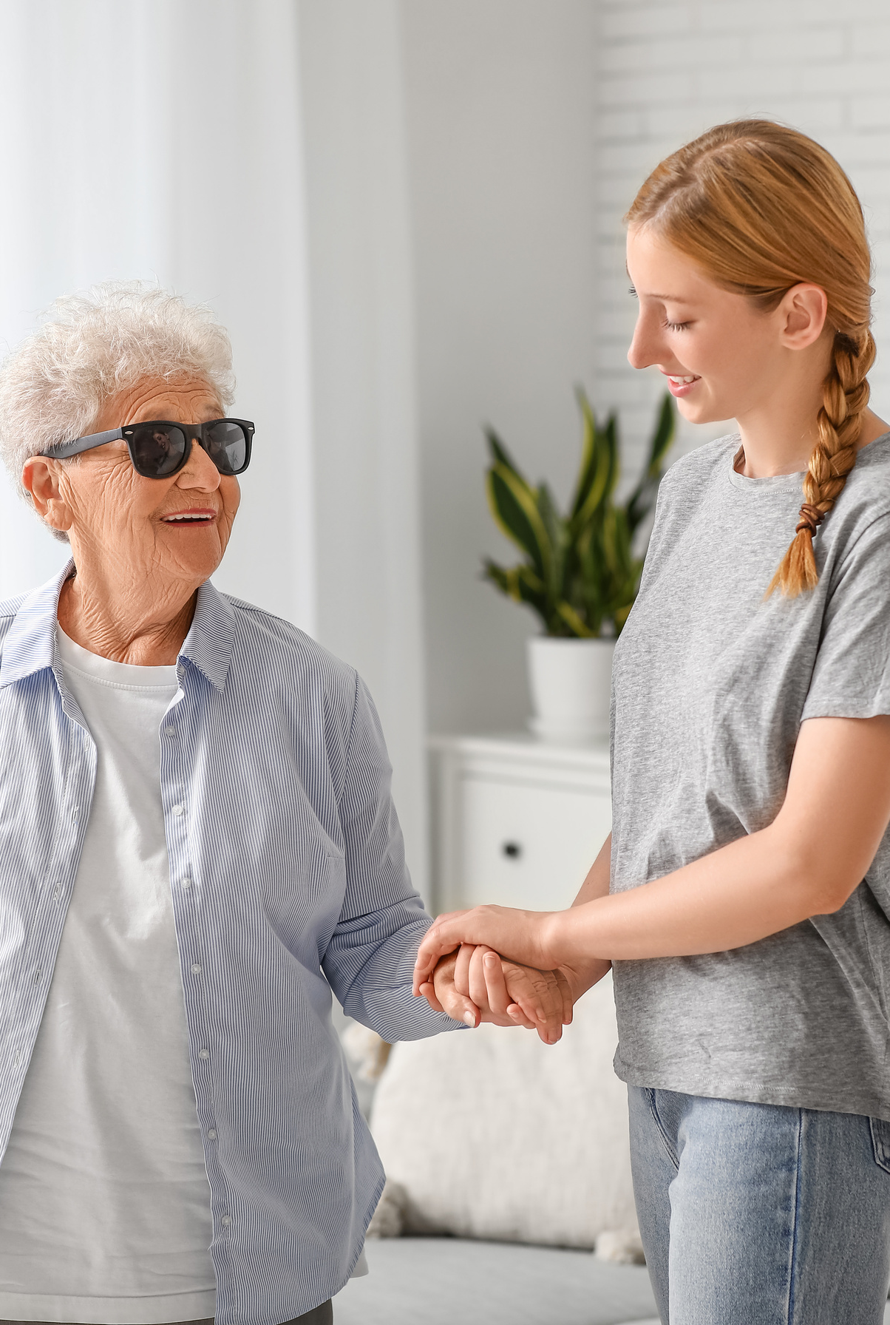



INTRODUCTION
WHAT IS A TREATMENT ROOM
PURPOSE OF A TREATMENT ROOM
BUDGET FOR TREATMENT ROOM

Slide 3

WHAT IS A TREATMENT ROOM
"In every city where we have a church, there is need of a place where treatment can be given. Among the homes of our church members there are few that afford room and facilities for the proper care of the sick. A place should be provided where treatment may be given for common ailments. The building might be inelegant and even rude, but it should be furnished with facilities for giving simple treatments. These, skillfully employed, would prove a blessing, not only to our own people, but to their neighbors, and might be the means of calling the attention of many to health principles". – {CH 468.1}

Slide 4
PURPOSE OF A TREATMENT ROOM
“God's purpose in giving the third angel's message to the world is to prepare a people to stand true to Him during the investigative judgment. This is the purpose for which we establish and maintain our publishing houses, our schools, our sanitariums, hygienic restaurants, treatment rooms, and food factories This is our purpose in carrying forward every line of work in the cause” MS 143, 1902.

Slide 5
TYPES OF TREATMENTS
  Migraine headache
  Upper back pain
  Lower back pain: sciatica
  Arthritic pain
  Injury pain
  Pain related to cancer

Slide 6

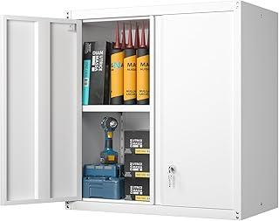
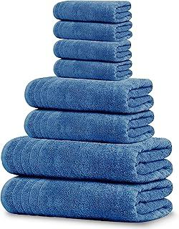
BUDGET FOR TREATMENT ROOM
SUGGESTED ITEMS
WALL CABINET TO STORE SUPPLIES $88.00 X 2= $176
HTTPS://A.CO/D/8TUEQKD
SET OF COTTON TOWEL $33.95
HTTPS://A.CO/D/ILWZGQK

Slide 7
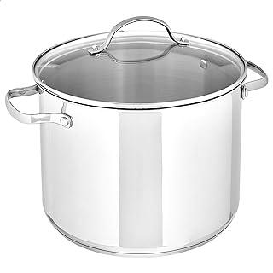
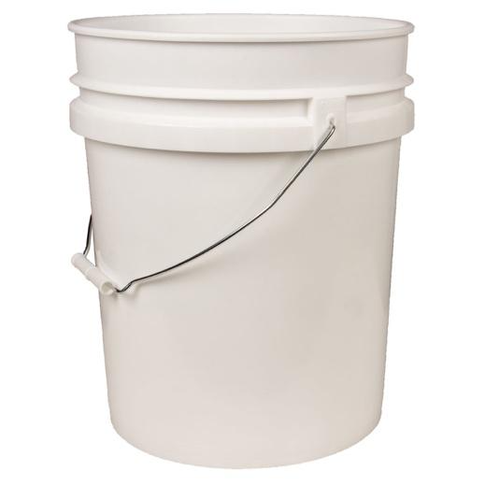
BUDGET FOR TREATMENT ROOM
SUGGESTED ITEMS
POT FOR HOT WATER $28.34
HTTPS://A.CO/D/2MMNO4P
5 GALLOON BUCKET $7.32
HTTPS://WWW.AZURESTANDARD.COM/SHOP/PRODUCT/HOUSEHOLD-FAMILY/STORAGE/BUCKETS-PAILS-LIDS/BUCKETS-PAILS/EMPTY-5-GALLON-PLASTIC-PAILBUCKET-WITHOUT-LID/7838?PACKAGE=PS092

Slide 8
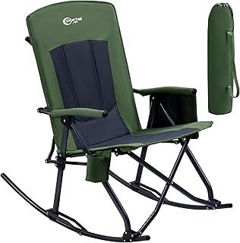
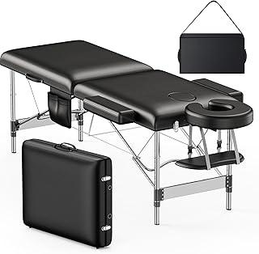
BUDGET FOR TREATMENT ROOM
SUGGESTED ITEMS
CHAIR FOR HYDROTHERAPY (MIGRAINE) $89.99
HTTPS://A.CO/D/GIFCM1P
MASSAGE TABLE $99.99
HTTPS://A.CO/D/9VYASYO

Slide 9
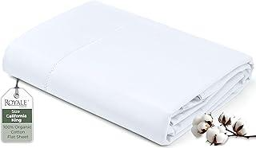
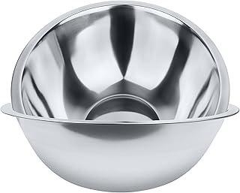
BUDGET FOR TREATMENT ROOM
SUGGESTED ITEMS
2 COTTON SHEETS $44
HTTPS://A.CO/D/GXD6YNJ
2, 5 QT STAINLESS STEEL BOWLS $17.95
HTTPS://A.CO/D/4QUQ7NX

Slide 10
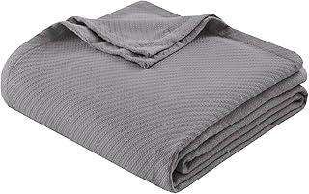
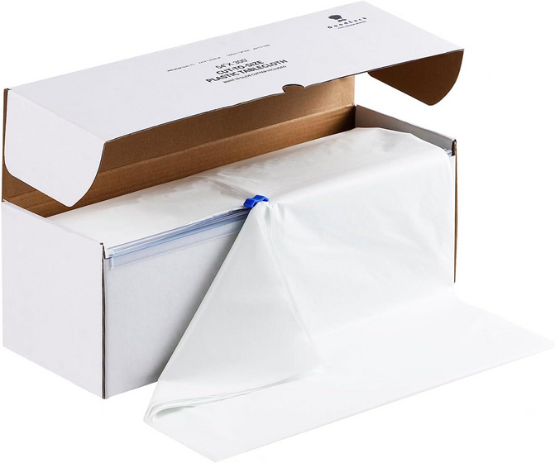
BUDGET FOR TREATMENT ROOM
SUGGESTED ITEMS
COTTON BLANKET $37.99
HTTPS://A.CO/D/BYRSSSP
PLASTIC FOR SAUNA $27.99
HTTPS://A.CO/D/EV0WKZZ

Slide 11
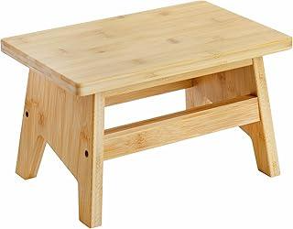
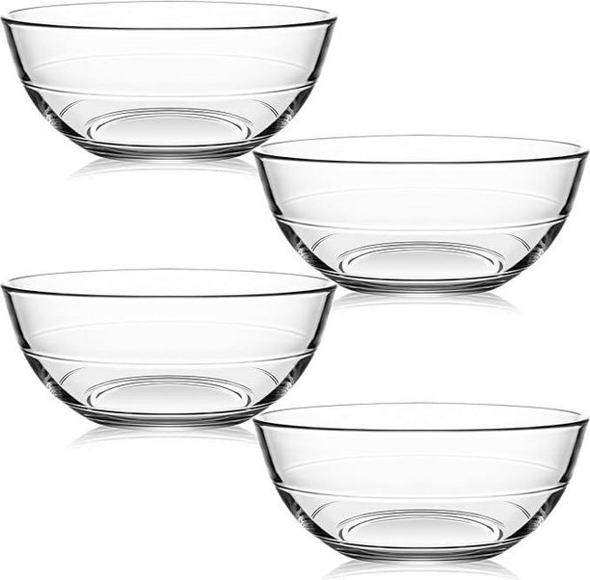
BUDGET FOR TREATMENT ROOM
SUGGESTED ITEMS
WOODEN STOOL $24.99
HTTPS://A.CO/D/0JKPYF7
GLASS BOWLS FOR POULTICES $24.99
HTTPS://A.CO/D/53IG74S

Slide 12
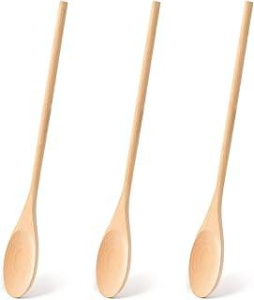
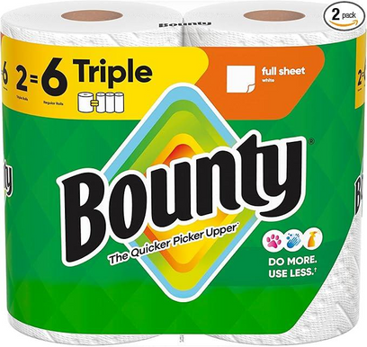
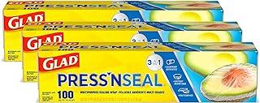
BUDGET FOR TREATMENT ROOM
SUGGESTED ITEMS
PAPER TOWEL $8.78
HTTPS://A.CO/D/ESH5JYP
WOODEN SPOONS $6.99
HTTPS://A.CO/D/1WUFZLX
TO WRAP $14.97
HTTPS://A.CO/D/5LPKFFI

Slide 13
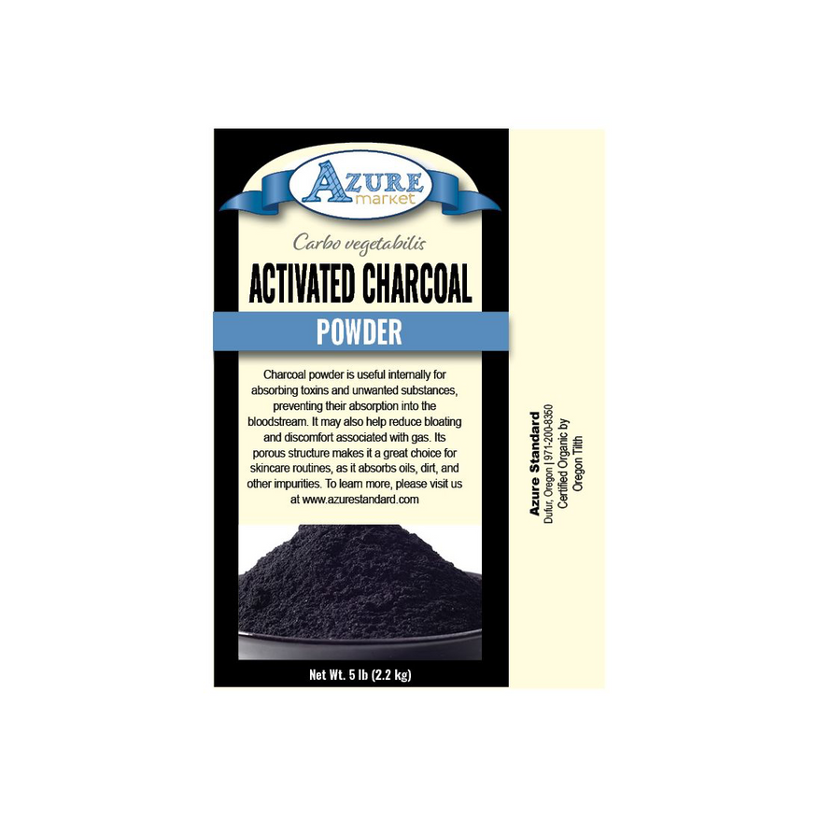
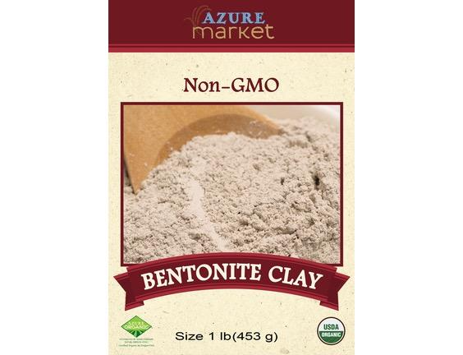
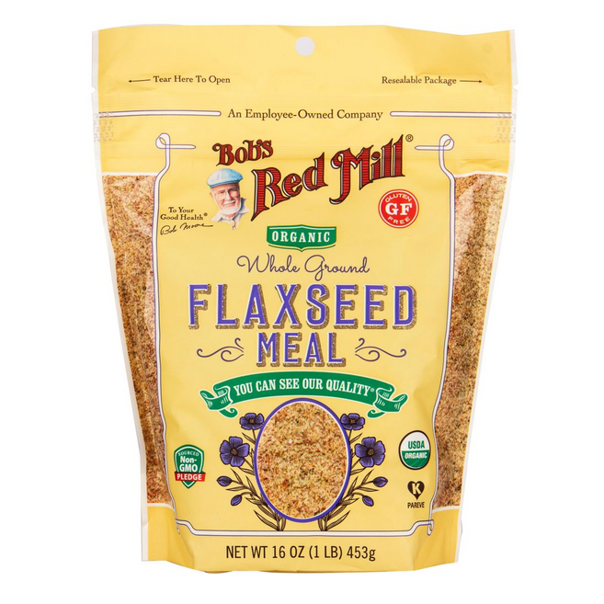
BUDGET FOR TREATMENT ROOM
SUGGESTED ITEMS
BENTONITE CLAY 1 LB. $6.52
HTTPS://WWW.AZURESTANDARD.COM/SHOP/PRODUCT/HEALTH-BEAUTY/HEALING-FIRST-AID/CLAY/BENTONITE/BENTONITE-CLAY/37512?PACKAGE=HB2390
ACTIVATED CHARCOAL 1 LB. $6.26
HTTPS://WWW.AZURESTANDARD.COM/SHOP/PRODUCT/NUTRITIONAL-SUPPLEMENTS/HERBS/SINGLE/CHARCOAL-ACTIVATED/POWDER/ACTIVATED-CHARCOAL-POWDER/7074?PACKAGE=HS386
FLAXSEED MEAL 1 LB. $5.13
HTTPS://WWW.AZURESTANDARD.COM/SHOP/PRODUCT/FOOD/FLOUR/NUT-SEED-MEALS/FLAX/FLAXSEED-MEAL-ORGANIC/8021?PACKAGE=FL203

Slide 14
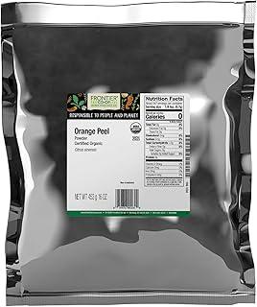
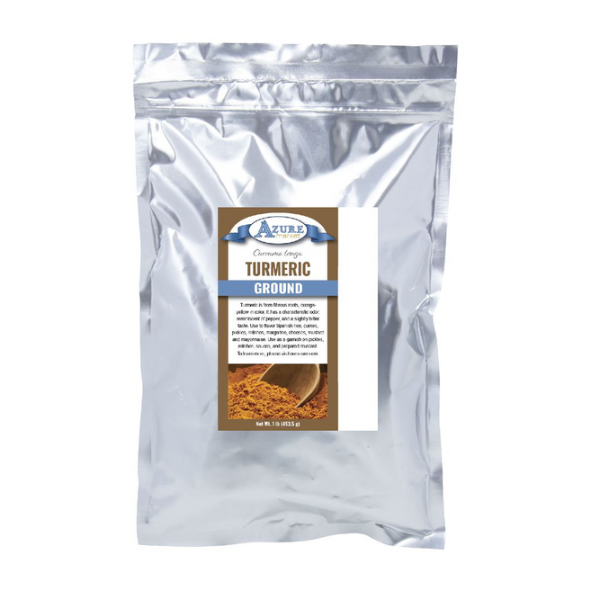
BUDGET FOR TREATMENT ROOM
SUGGESTED ITEMS
TURMERIC POWDER, ORGANIC, 1 LB. $6.59
HTTPS://WWW.AZURESTANDARD.COM/SHOP/PRODUCT/FOOD/SPICES-SEASONINGS/SPICES/TURMERIC/DRIED/TURMERIC-GROUND/11402?PACKAGE=HS222
ORANGE PEEL POWDER, ORGANIC, 1 LB. $17.95
HTTPS://A.CO/D/80ANYHY
TOTAL COST: $686.69
APPROXIMATELY BUDGET TO
START A TREATMENT ROOM: $700

