Slide 1
Simple remedies for treatment rooms

Slide 2
Leg bath
Place legs (below knees) in hot water as tolerated, cover with a towel
Keep head cool with a cool towel, until pain is gone (15-20 minutes)
Perform 1-2xday

Slide 3
Indications
Types of Migraine
Migraine with aura (could be manifested: vision changes, tingling, difficulty speaking)
Migraine without aura (common migraine)
Silent Migraine (aura, visual disturbances, dizziness, nausea)
Hemiplegic Migraine: (symptoms such as stroke)
Hemiplegic Migraine (symptoms similar to a stroke)
Retinal Migraine (visual disturbances in one eye
Menstrual Migraine
Abdominal Migraine
Chronic Migraine (15 or more days)

Slide 4
Indications
Coffee withdrawal headache
If no relief of pain, seek for medical care

Slide 5

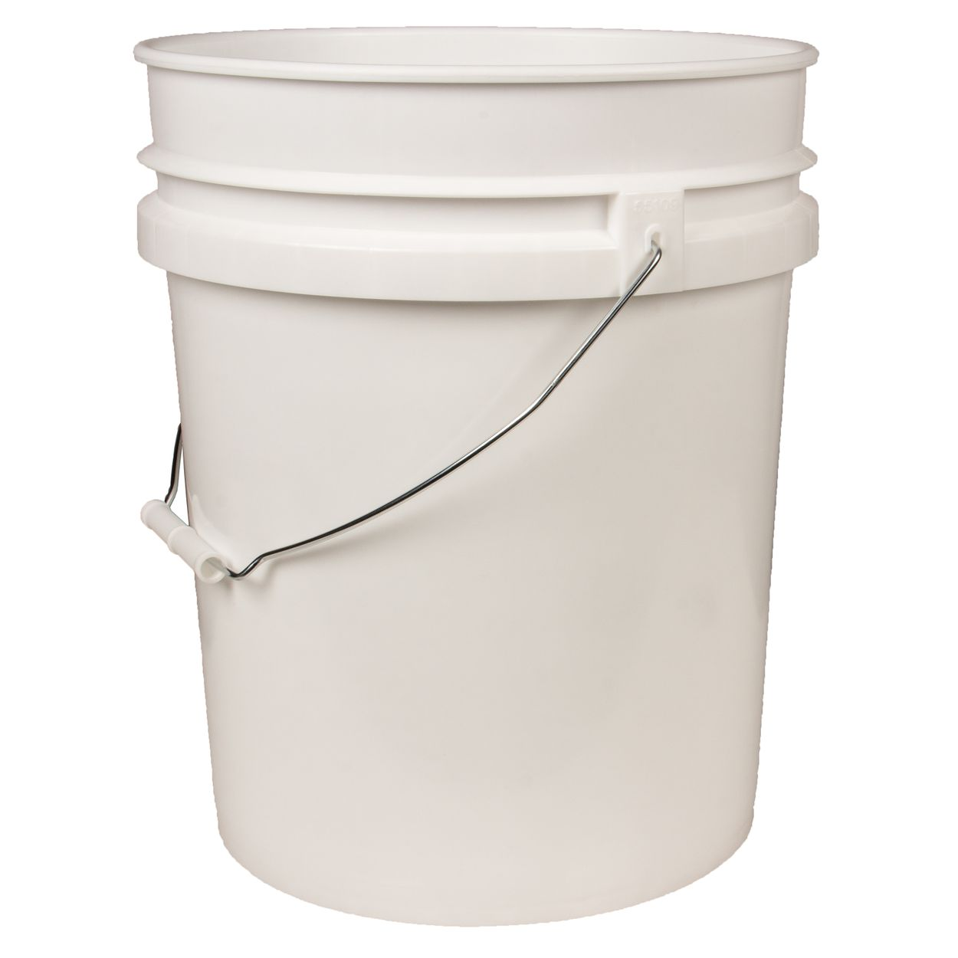
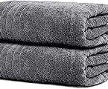
Supplies for leg bath

Slide 6
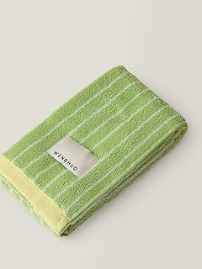
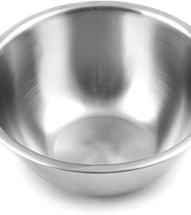
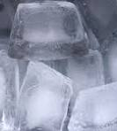
Supplies for leg bath

Slide 7
Hydrotherapy for pain
Apply hot towels over painful back area. Switch towels often, until pain Is gone (15-20 minutes)
End with cool friction using a towel.
Apply ginger poultice over the painful area and keep it throughout the night

Slide 8
Indications
Upper back pain
Mid back pain
Lower back pain (not sciatica)
Shoulder pain
Muscle pain
Bone pain

Slide 9
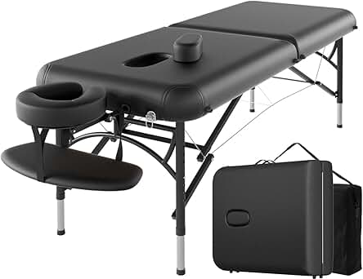
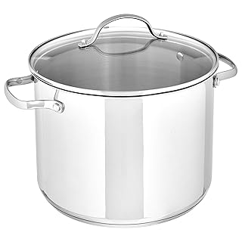
Supplies for Hydrotherapy pain

Slide 10
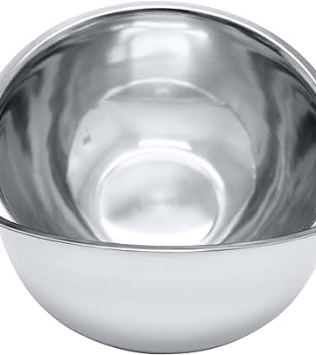
Supplies for hydrotherapy pain

Slide 11
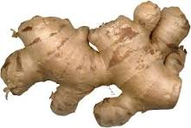
Ginger Poultice
Grind ginger using a blender or a food processor..
Apply ginger between paper towel.
Place poultice over painful area and secure with press n seal

Slide 12
Indication
Apply ginger poultice after applying hot towels and cool friction
Will keep heat through the night
Helps back pain
Helps nerve pain

Slide 13
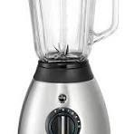
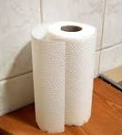

Supplies for ginger poultice

Slide 14
Home sauna
Place hot water next to stool to raise temperature
Remain sited for 20 minutes-30 minutes
Seat on a short stool
Wrap whole body with a large sheet
Cover with a plastic
Place a blanket over plastic

Slide 15
Indication
Upper and lower respiratory infection
Covid
Detox
Very helpful in people that do not sweat and cannot exercise

Slide 16
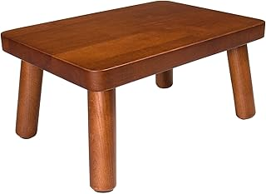
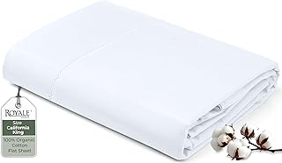
Supplies for home sauna

Slide 17
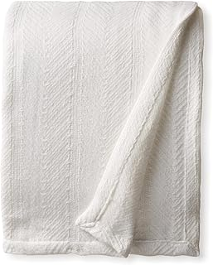

Supplies for home sauna

Slide 18
Clay poultice
6 Tbsp clay
2 Tbsp ground flaxseed
Water as needed
Mix clay and flaxseed, add water slowly and stir until paste is form
Spread paste over towel paper
Place from spine to painful area (diagonal)
Secure with press n seal
Keep it over night

Slide 19
Indication
Nerve pain
Pinching nerve pain
Sciatica

Slide 20
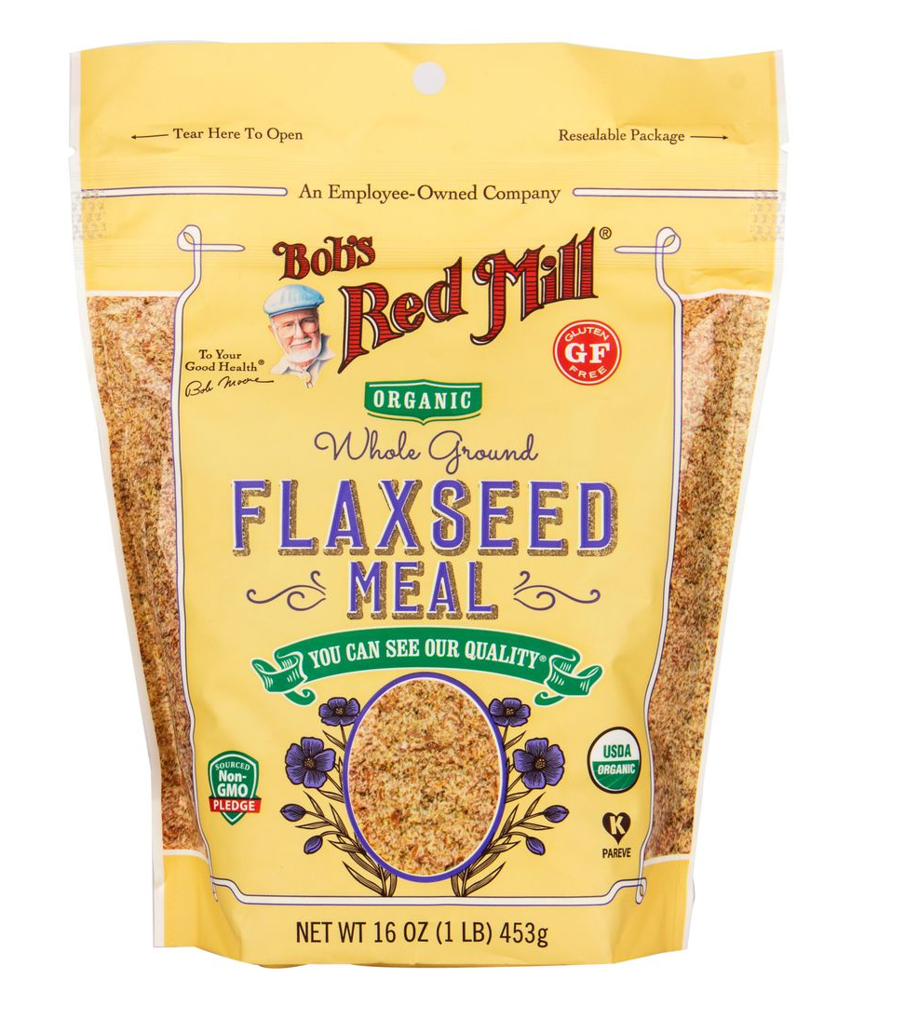
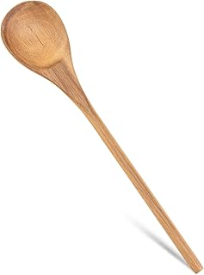
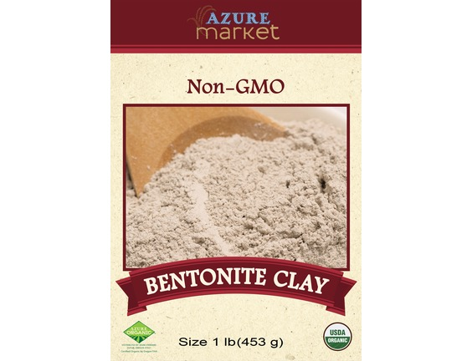
Supplies for sciatica poultice

Slide 21
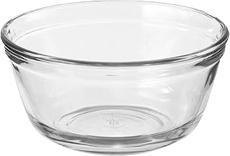
Supplies for sciatica poultice

Slide 22
Charcoal poultice
Mix charcoal and flaxseed, add water slowly and stir until paste is formed
6 Tbsp activated charcoal
2 Tbsp flaxseed
Spread paste over towel paper
Applied to desire area
Secure with press n seal
Keep poultice over night

Slide 23
Indication
Insomnia
Digestion issues
Infections
Kidney failure
Injury

Slide 24
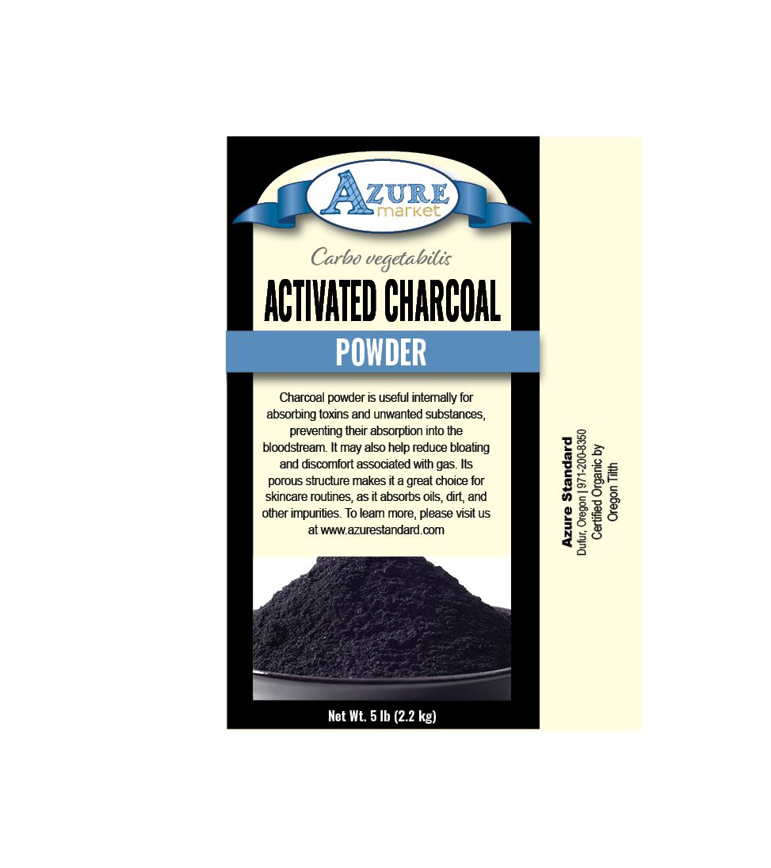
Supplies for Charcoal poultice

Slide 25
Supplies for Charcoal poultice

Slide 26
Turmeric orange poultice
2 Tbsp turmeric
2 Tbsp orange peel powder
2 Tbsp flaxseed grounded
Mix turmeric, orange peel and flaxseed, add water slowly and stir until paste is form
Spread paste over towel paper
Applied to desire area
Secure with press n seal
Keep poultice over night

Slide 27
Indication
Join pain
Arthritis pain
Muscle pain
Foot pain

Slide 28
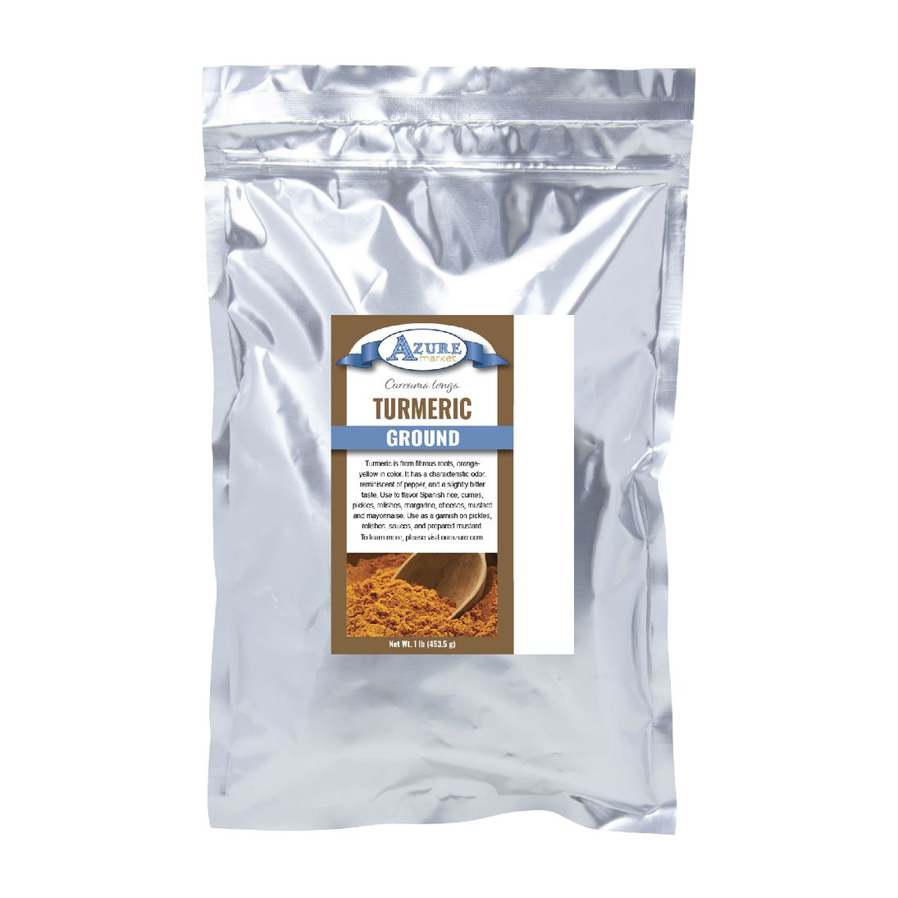
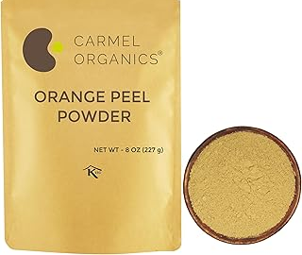
Supplies for turmeric-orange peel poultice

Slide 29
Supplies for turmeric-orange peel poultice

